Slide 1
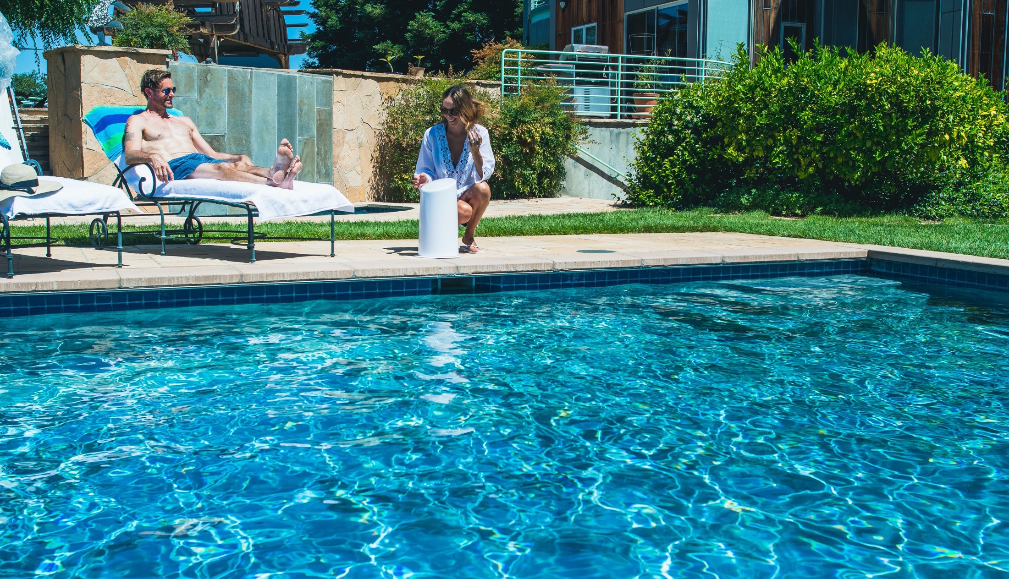

The Future of Pool Water Care
Disrupting a $3B market
Confidential – please do not circulate without permission

Slide 2

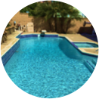

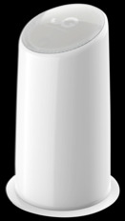
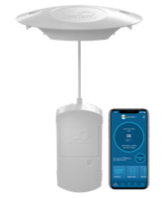
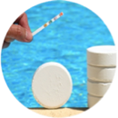
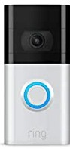
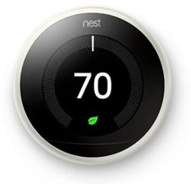
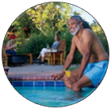
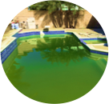
Mega Trends + White Space = WaterGuru
Appliance- enabled services
9 million owner managed pools
Appliance-enabled high-margin recurring revenues
Home automation
$3B/year sticky ARR
Home pools are hot
Headaches to keep clean & safe
30% penetration yields
$1B revenues PLUS
$700M ARR

Slide 3

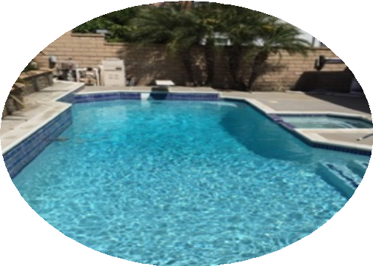
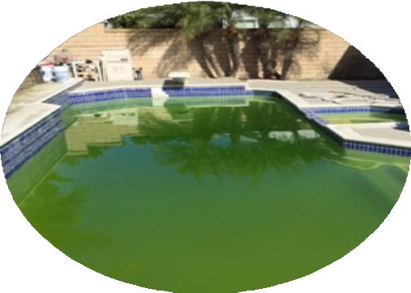
9 million hate pool water care
Experiencing major water problems every year with no automated solution
Weekly hassle to keep Safe and Clear
Expensive Problem to resolve every 1-3 years
3
* 68% experienced problem in the past 3 years requiring draining pool and restarting. Over 50% said they had a major problem in the. past year. 61% Leslie’s, 57% Salt pools, 47% serviced pools in survey of 1022 pool owners ** 69% want automation of water care in a 4,000 pool owners in extensive research which guided product development

Slide 4
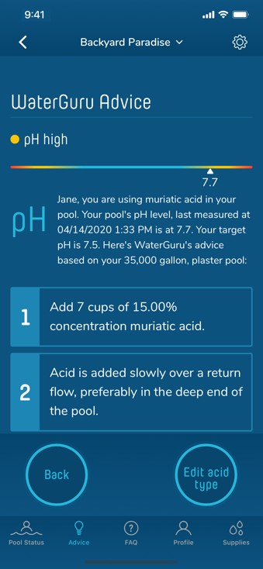
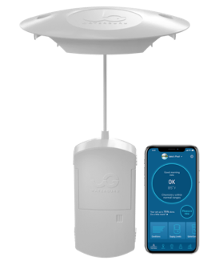

Measures & advises for perfect pool water
Cloud managed appliance
Over 3,000 units sold with soft launch Over 97% reorder supplies
Happy customers with high NPS score

Slide 5
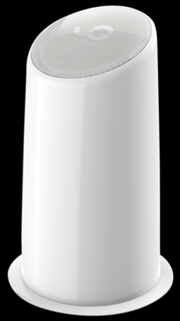



Treats pool water automatically
First & only to test & treat pool water Cloud managed appliance Proprietary consumables
Spend same as DIY, 25% of serviced pools Manufactured in US, in pilot
5

Slide 6
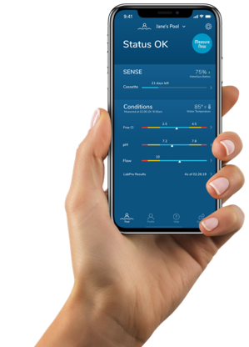
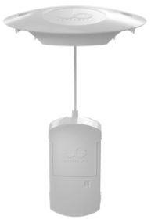
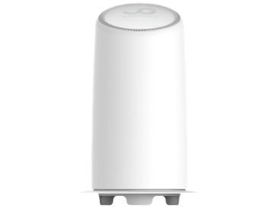


Proven D2C model with high margins
$295 for starter kit $595 for starter kit
>$200/year ARR >$400/year ARR
> $5,000 lifetime value > $10,000 lifetime value
70% SENSE customers want to upgrade

Slide 7
$3B/year Current Spend
Recession-resistant, non-discretionary spending
Nine million residential pools, only 10% maintained by a pool guy!
Self-service in-ground pools
Serviced pools
Above ground
Spas Hot tubs
$1,450M/year | $550M | $500M | $800M
7

Slide 8
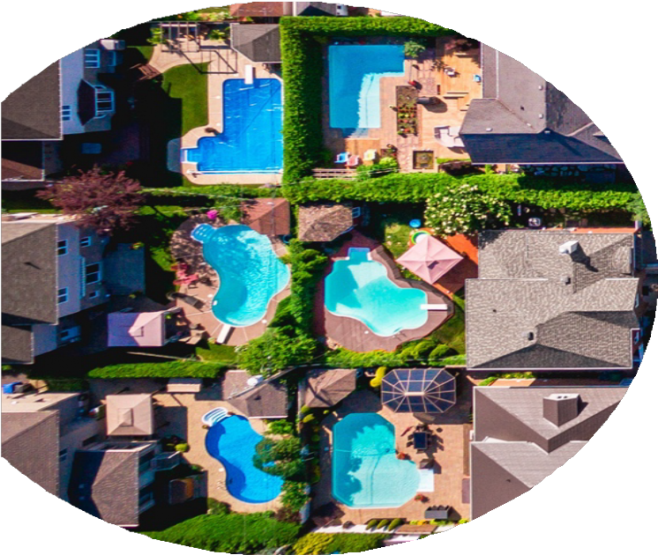
Efficient go-to-market with great traction
Nine million addresses for marketing Direct mail, addressable DRTV, digital SENSE/TREAT CAC around $100 One-click in App supplies reorders Pool water as a service
8

Slide 9

WaterGuru beats the competition
TREAT: only automatic water care system at a quarter of the cost of a pool-guy
SENSE: more accurate and cheaper than Phin & Sutro

Slide 10
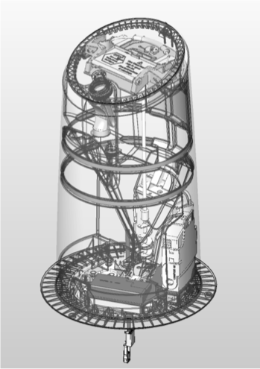
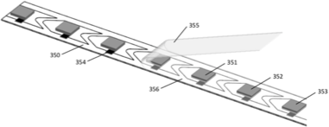

Patented & Ready to Scale
$15M in unique multi-disciplinary R&D
granted and 8 pending patents
strategic suppliers allow us to scale
Key claim areas: Pool side devices to dispense powdered and liquid chemicals. Over 30 safety features required to fill, store and dispense chemicals. Colorimetric pads & strips for analyzing pool chemistry. Chemistry for stabilizing reagents on colorimetric pads. Powder dispenser compatible with clumping powder. Equipment pad low pressure chemical injection. Acoustic and thermal flow sensors

Slide 11
Passion, Grit, Experience
TEDDY SHALON
Founder & CEO
ANDRE ATEMASOV
VP Demand Generation
RAFI FRIED
EVP Product Development
RICHARD FALK
Founder & Chief Guru
Multiple exits exceeding
$100M. Inventor / Entrepreneur with over 50 patents. Founder of life science companies: Synteni, AirXpanders, Neosil, Theracaine, Osteogenix and consumer facing ThinOPTICS and Dreamade.
Ran both startup brands & large corporate marketing departments - Williams Sonoma, Rodin & Fields, Vintage Wine Estates.
PhD Electrical Engineering. 25+ years driving projects from concept to large volume mass production. Managed small teams in startups and large teams in public companies
Expert in pool and spa water chemistry.
Primary contributor to “Trouble-Free Pool” forum with over 3M visitors per year.
Specializing in digital acquisition and customer retention.
30+ years of experience in software projects.
Multiple successful exits: Passif (acquired by Apple), Integration (acquired by Silicon Labs), Atmel (acquired by Microchip), Silicon Labs, and DSP Group (IPO).
Four decades of startup experience in multidisciplinary product development and commercial launch experience.
20+ years successful multi- channel marketing.
Advisers:
ROBERT BAIRD Sigura Water CEO, top pool chemical purveyor
LARRY BLOOM former CEO BioLab pool chemicals & CoB National Spa and Pool Institute
GIACOMO MARINI founder & former COO Logitech, CEO Neato Robotics room sweepers
11

Slide 12
Revenue stage with clear path to growth
$100M
216,000 pools
$106M revenues
$75M
$55M recurring ARR
58% gross margins
$50M
$17M EBITA
$25M
Initial revenues Recurring revenues EBITA
2023
124
2.3%
2024
216
4.0%
2021
2022
19
0.3%
57
1.1%
Pools K
Penetration
12

Slide 13

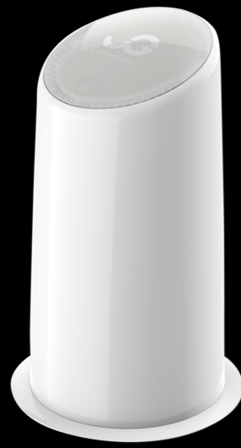
Investment Opportunity
$10M - 15M capital raise
Scale commercialization of SENSE & TREAT Clear Ventures, Lauder Partners, Sigura Water*
13
* One of the largest pool chemical manufacturers in the world

Slide 14

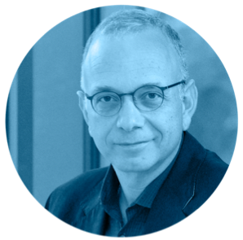
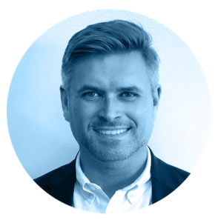
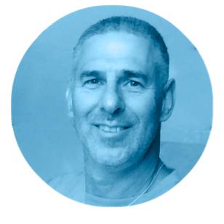

Why invest with us?
High demand
$3B/year market Recurring revenues Strong margins Efficient D2C selling Experienced team Patent protected
14

Slide 15



Thanks for listening.
Contact teddy@waterguru.com / 650.533.4030

Slide 16

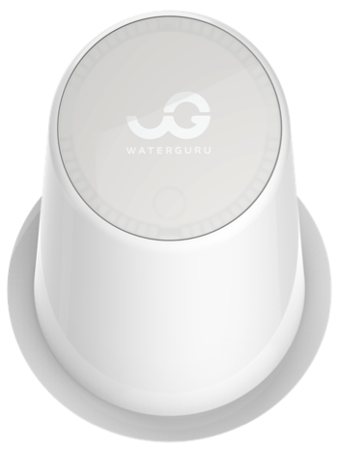



WaterGuru yearly potential savings*
43 54
Billion gallons
Water
CYA free solution
$65/pool
Million pounds
Chemicals
Chlorination & Algaecides
$74/pool
3.5
billion kWh
Electricity
turbidity pool pump
$216/pool
* US based 6M in-ground 18K gallons pools, 60% using trichlor, average 6 months season

Slide 17
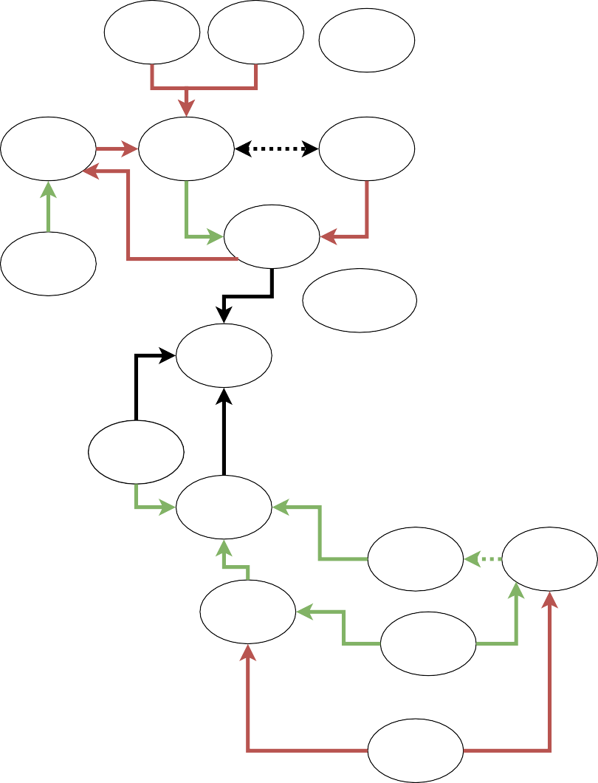

Nitrates
Sunlight
High Bather Load, Debris
Trichlor
Pool chemistry is complicated !
Algae Growth
Free Chlorine
Cyanuric Acid
Everything interacts with everything else…
Saltwater Chlorine Generator
Active Chlorine
Phosphates
Aeration,
Carbon Dioxide
Undissolved Chlorine Gas Outgassing
WaterGuru is the only system that leverages lab grade chemistry measurements, daily monitoring of chlorine & pH, and cloud based AI algorithms to customize pool treatment
Outgassing
HEDP-based Metal Sequestrants
Pool Water Balance
Proper Plaster Curing
Temperature
pH
pH Up, Soda Ash
Calcite Saturation Index
Consumed Chlorine (All Types)
Carbonate Alkalinity
Total Alkalinity
Total Dissolved Solids,
Salt
Calcium Hardness
Evaporation and Refill
Soft Stone Deterioration
Metal Corrosion
Water Dilution

Slide 18
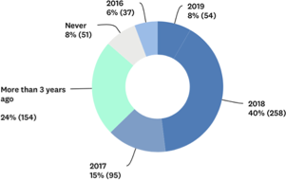
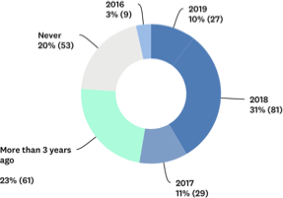
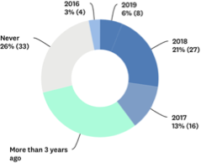
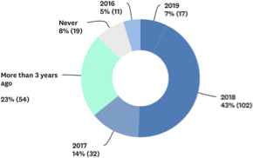
When was the last time the pool water had a problem?
DIY Chlorine: 68% past 3 years, 8% never ₆₇₄ Salt: 57% past 3 years, 20% never ₂₇₄
Serviced: 43% past 3 years, 26% never ₁₄₉
Buy @ Leslie’s: 61% past 3 years, 8% never ₂₄₄

Slide 19
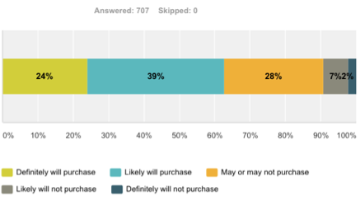
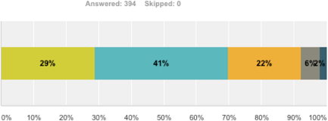
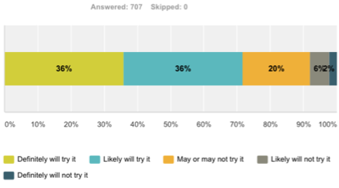
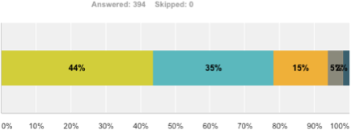
After seeing TREAT: 70% Purchase intent!
Everyone
Purchase intent
Target
63%
70%
Trial intent
72%
79%
Confidential | 19

Slide 20
Beats competition on benefits, reliability and price
Water care method | Auto Sense | Auto Dispense | Avoid CYA buildup problems* | Capture lifetime value⁺ | One time cost | Annual costs
WaterGuru Treat | ◉ | ◉ | ◉ | ◉ | $595 | $400
DIY - Floater/Feeder | ◉ | ◉ | ◉ | ◉ | $50/150 | $550
Saltwater generator | ◉ | ◉ | ◉ | ◉ | $2100 | $310
Serviced pools | ○ | ○ | ◉ | ◉ | n/a | $1500
pHin⁺⁺ | ◉ | ◉ | ◉ | ◉ | $340 | $600
Sutro | ◉ | ◉ | ◉ | ◉ | $695 | $600
* Based on over 4,000 pool owner surveys. Water problems in past 3 years from our pool owner surveys: 80% with trichlor maintained pools, 66% of serviced pools. CDC to set maximum CYA levels in pools + Sticky recurring revenues, Floater/Feeder based on retail churn (30% loyal 5 years out) and service churn ++Phin & Hayward/Pentair measures ORP (NOT chlorine) and pH. Phin & Sutro advise the user what to add to keep pool water in balance. Phin includes $99 annual subscription fee. Pentair, manual and serviced pools experience problems based on dispensing Trichlor. Fixed dispense devices add chlorine regardless of how much is needed. Recurring revenues of annual costs based on proprietary consumables. Annual costs based on typical 18,000 gallon pool.
20

Slide 21
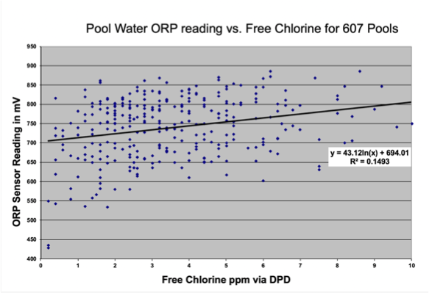
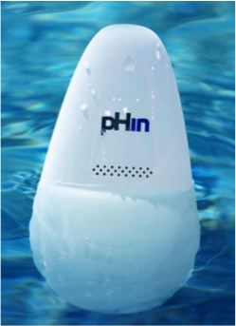
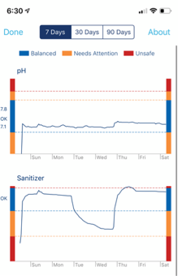
ORP sensors don’t measure Free Chlorine
ORP based
In presence of CYA, ORP is poorly correlated with Free Chlorine & requires constant calibration

Slide 22
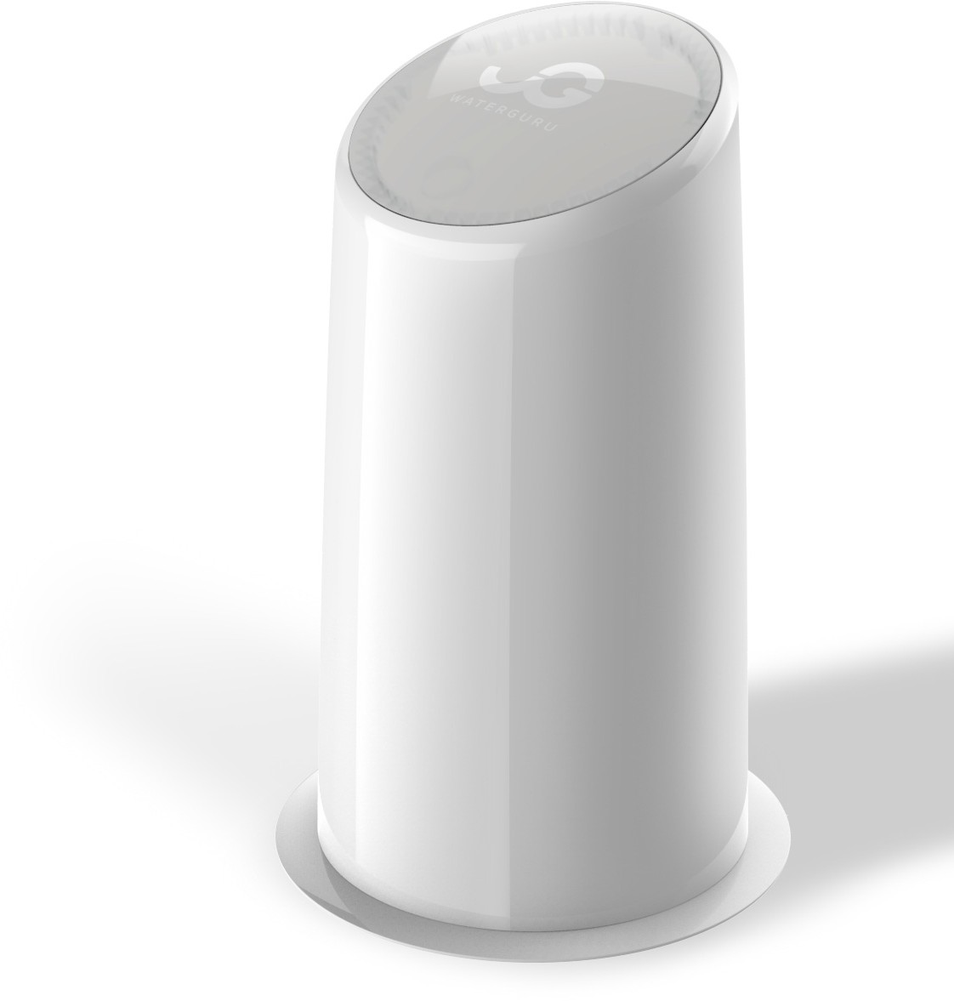

Many states began to regulate CYA
Maximu m ppm | # | States
0 | 2 | Alaska, New York
30 | 1 | Wisconsin
50 | 3 | Kentucky, Nebraska, New Hampshire
60 | 1 | Indiana
70 | 1 | Ohio
80 | 2 | Iowa, Michigan
100 | 23 | California, Texas, Florida, + others
150 | 2 | Arizona, Oregon
Reach in 3 months of use, CDC maximum guidance =90
Confidential | 22

Slide 23
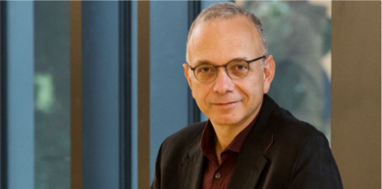
Teddy Shalon Bio
Teddy Shalon has four decades of experience as an accomplished entrepreneur, focusing on multidisciplinary ventures. During this time, he has applied his broad technical background, spanning, material science, electronics, software, optics, pharmaceutical development, and clinical science, in formation of multiple startups. Teddy is also experienced in management, marketing and finance. He’s applied these skills, assembling and leading several product teams into fully integrated companies.
Teddy started his first company when he was 22. It developed surgical devices. He then moved on to medical informatics and founded Ivy Technologies and served as its President and CTO from its inception until its acquisition by a biomedical subsidiary of Nestlé. He subsequently co- founded a life science incubator, Metaphase, where he oversaw all technical and clinical developments.
Teddy continued as an executive with two of the companies that emerged from Metaphase, taking each from its formation through its exit. BioPolymerix, a developer of inert antimicrobial coatings for medical applications, was acquired by Biocompatibles International. Synteni, a developer of microarrays for measuring gene expression acquired by Incyte Genomics.
As the managing director of Shalon Ventures Research dedicated to creating and investing in seed multidisciplinary projects. He founded and led the development of several companies including Neosil, a dermatology-focused specialty pharmaceutical company (sold to Peplin); AirXpanders a reconstructive surgery device company; Osteogenix an orthobiologic company (sold to Medtronic); Theracaine, a company focusing on an opioid- free solution for post-operative pain; ThinOptics, creating ultrathin glasses and WaterGuru, a recreational water purification company. He also serves as a general partner at Prolog Ventures where he vets the technology of its investments.
Teddy was born in Israel in 1957 and came to the U.S. in 1970. He received an M.S. in Computer Science, a B.A. in Physics, and a B.S. in Electrical Engineering from Washington University. He lives and works in Palo Alto with his wife Michal, and has a daughter Tesha and two sons Liam and Nitan.

